Slide 1
Redux Breakdown

Slide 2
Redux breakdown
Initial setup:
A Redux store is created using a root reducer function
The store calls the root reducer once, and saves the return value as its initial state
When the UI is first rendered, UI components access the current state of the Redux store, and use that data to decide what to render. They also subscribe to any future store updates so they can know if the state has changed.
Updates:
Something happens in the app, such as a user clicking a button
The app code dispatches an action to the Redux store, like dispatch({type: 'counter/increment'})
The store runs the reducer function again with the previous state and the current action, and saves the return value as the new state
The store notifies all parts of the UI that are subscribed that the store has been updated
Each UI component that needs data from the store checks to see if the parts of the state they need have changed.
Each component that sees its data has changed forces a re-render with the new data, so it can update what's shown on the screen

Slide 3
Data flow image

Slide 4
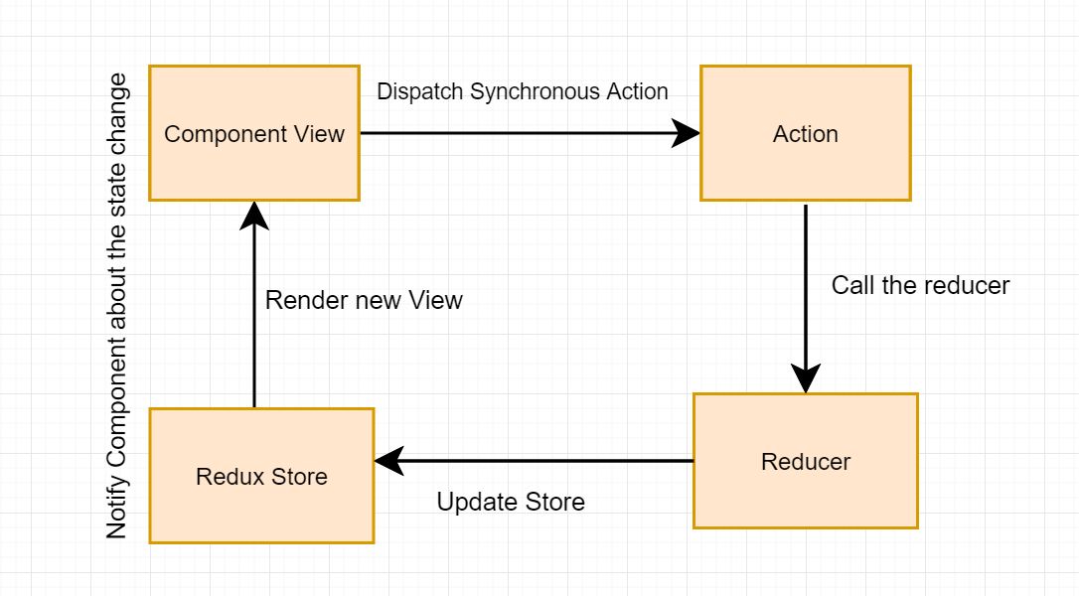
Data flow chart

Slide 5
Using Redux Data
It’s simple to get access to the store inside a React class component – no need to pass the store as a prop or import it, just use the connect function from React Redux, and supply a mapStateToProps function that pulls out the data you need.
In functional component you can use useSelector hooks to access redux store.
Then, inside the component, you can pass that data to a function that needs it.

Slide 6
Access redux store example
Class Component:
const mapStateToProps = state => ({
authToken: state.currentUser && state.currentUser.authToken,
items: state.items
});
export connect(mapStateToProps)(ItemList);
Functional Component:
const todo = useSelector(state => state.todos[props.id])

